Slide 1

Packages & plugins
Wenxuan Shi
College of Software, Nankai University
Email: shiwx@nankai.edu.cn
Wechat: 13920561100

Slide 2
Topics
Using packages
Developing packages & plugins
Flutter Favorites program

Slide 3
Using packages
Notes:
StatelessWidget is used for immutable elements that only rely on the object configuration information
StatefulWidget is used for elements that can dynamically change based on state-changes in the system
Everytime that state changes, setChange() is called by the object

Slide 4
Introduction
Flutter supports using shared packages contributed by other developers to the Flutter and Dart ecosystems.
This allows quickly building an app without having to develop everything from scratch.

Slide 5
Using packages
Searching for packages
Packages are published to pub.dev.
The Flutter landing page on pub.dev displays top packages that are compatible with Flutter (those that declare dependencies generally compatible with Flutter), and supports searching among all published packages.
The Flutter Favorites page on pub.dev lists the plugins and packages that have been identified as packages you should first consider using when writing your app. For more information on what it means to be a Flutter Favorite, see the Flutter Favorites program.

Slide 6
Adding a package dependency to an app
To add the package, css_colors, to an app:
Depend on it
Open the pubspec.yaml file located inside the app folder, and add css_colors: under dependencies.
Install it
From the terminal: Run flutter pub get.

Slide 7
Import it
Add a corresponding import statement in the Dart code.
Stop and restart the app, if necessary
If the package brings platform-specific code (Kotlin/Java for Android, Swift/Objective-C for iOS), that code must be built into your app.

Slide 8
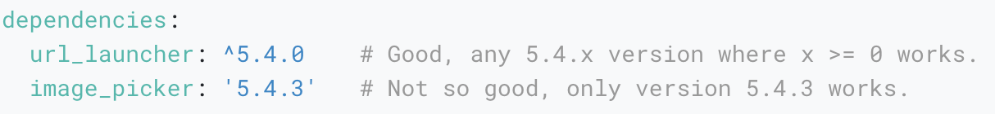
Conflict resolution
Suppose you want to use some_package and another_package in an app, and both of these depend on url_launcher, but in different versions. That causes a potential conflict.
The best way to avoid this is for package authors to use version ranges rather than specific versions when specifying dependencies.

Slide 9
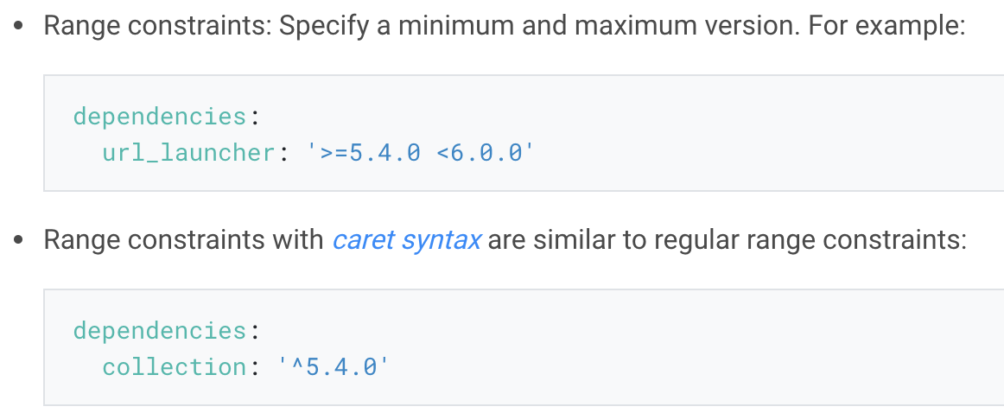
Managing package dependencies and versions
Package versions
All packages have a version number, specified in the package’s pubspec.yaml file.
The current version of a package is displayed next to its name, as well as a list of all prior versions.

Slide 10
Updating package dependencies
When running flutter pub get for the first time after adding a package, Flutter saves the concrete package version found in the pubspec.lock lockfile.
This ensures that you get the same version again if you, or another developer on your team, run flutter pub get.

Slide 11
Dependencies on unpublished packages
Packages can be used even when not published on pub.dev.
For private plugins, or for packages not ready for publishing, additional dependency options are available:

Slide 12
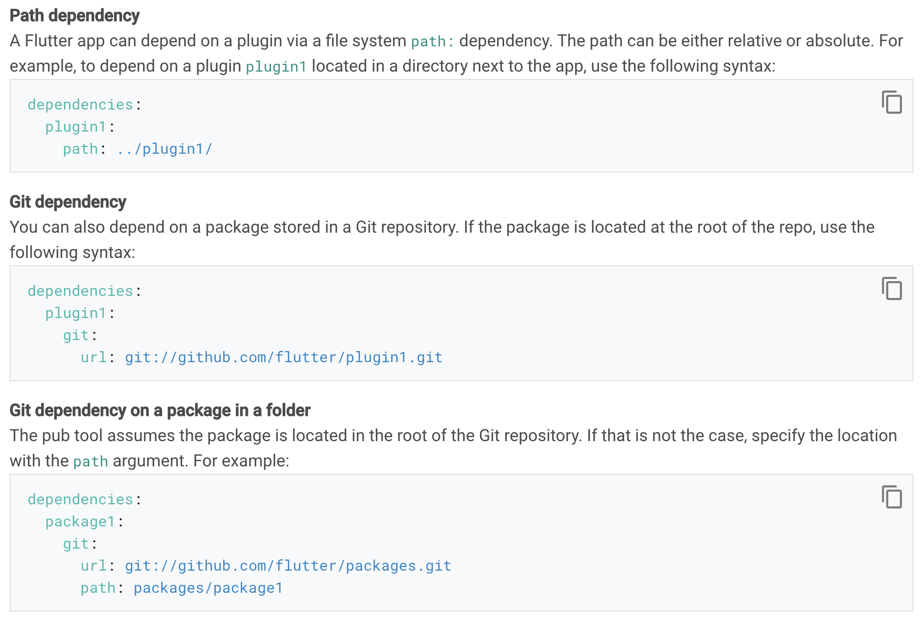

Slide 13
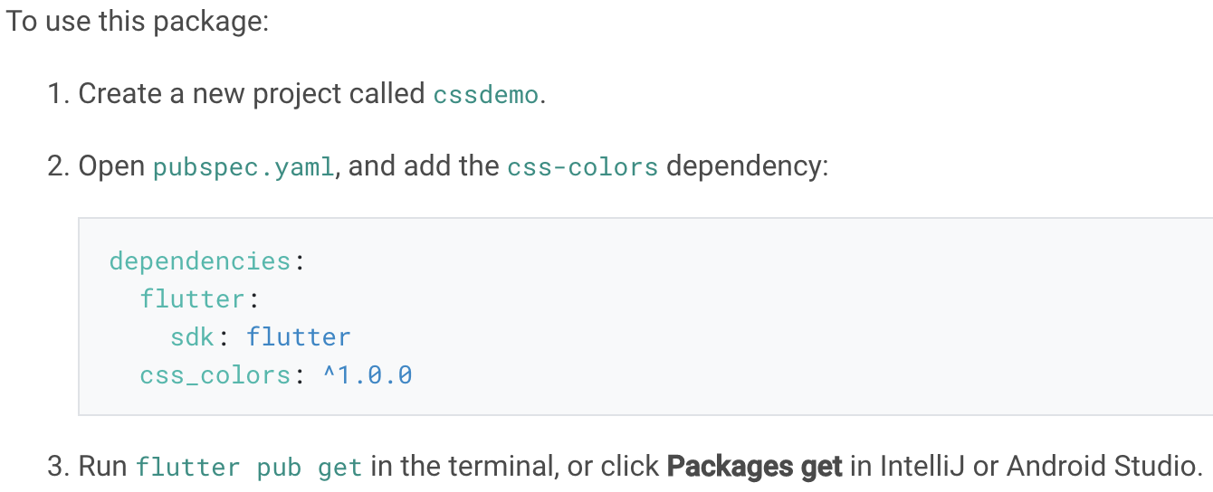
Examples
Example: Using the css_colors package
The css_colors package defines color constants for CSS colors, so use the constants wherever the Flutter framework expects the Color type.

Slide 14
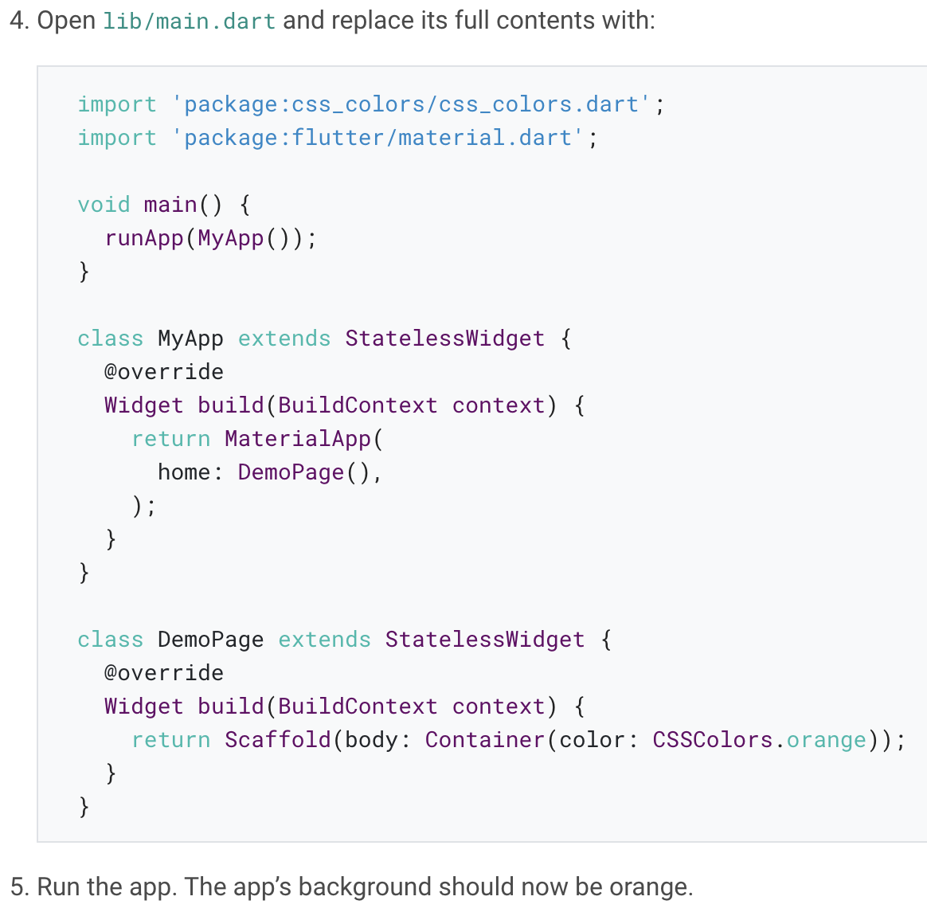

Slide 15
Example: Using the url_launcher package to launch the browser
The url_launcher plugin package enables opening the default browser on the mobile platform to display a given URL, and is supported on Android, iOS, web, and macos.
This package is a special Dart package called a plugin package (or plugin), which includes platform-specific code.

Slide 16
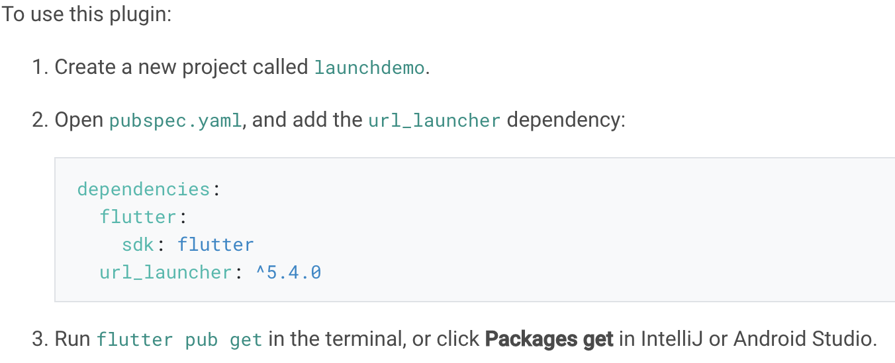

Slide 17
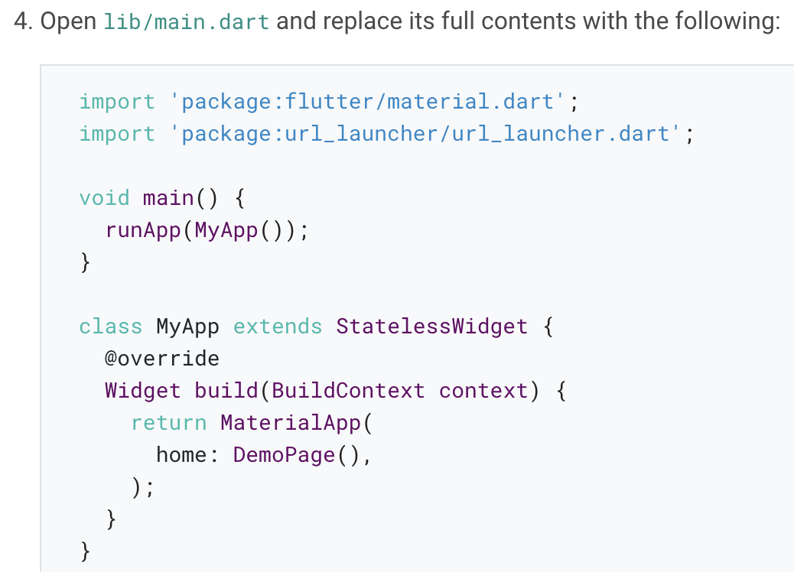

Slide 18
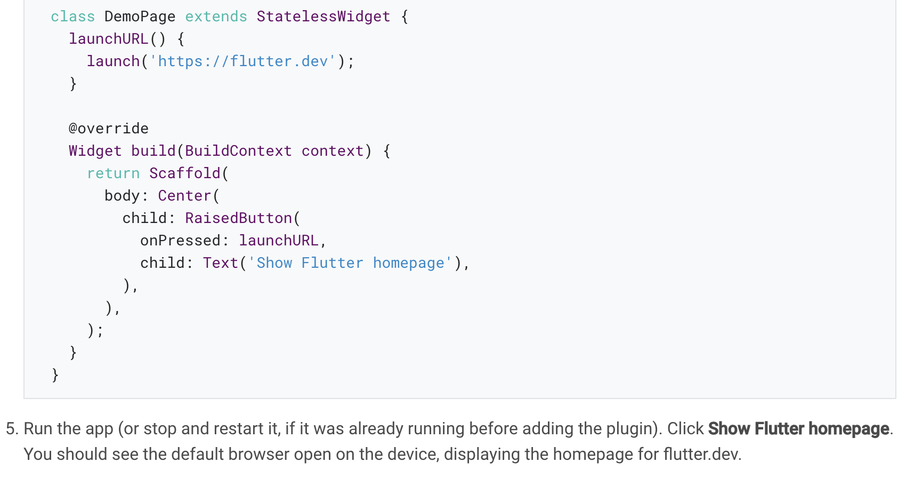

Slide 19
Developing packages & plugins
Notes:
StatelessWidget is used for immutable elements that only rely on the object configuration information
StatefulWidget is used for elements that can dynamically change based on state-changes in the system
Everytime that state changes, setChange() is called by the object

Slide 20
Package introduction
Packages enable the creation of modular code that can be shared easily.
A minimal package consists of the following:
pubspec.yaml: A metadata file that declares the package name, version, author, and so on.
Lib: The lib directory contains the public code in the package, minimally a single <package-name>.dart file.

Slide 21
Package types
Dart packages: General packages written in Dart, for example the path package. Some of these might contain Flutter specific functionality and thus have a dependency on the Flutter framework, restricting their use to Flutter only, for example the fluro package.
Plugin packages: A specialized Dart package that contains an API written in Dart code combined with one or more platform-specific implementations.

Slide 22
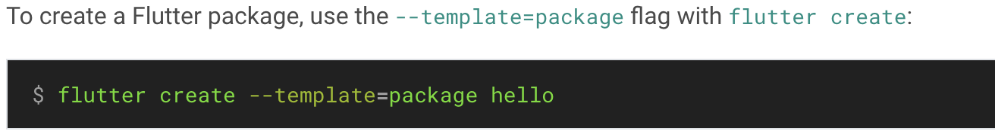
Developing Dart packages
Step 1: Create the package

Slide 23
Step 2: Implement the package
For pure Dart packages, simply add the functionality inside the main lib/<package name>.dart file, or in several files in the lib directory.
To test the package, add unit tests in a test directory.
For additional details on how to organize the package contents, see the Dart library package documentation.

Slide 24
Developing plugin packages
If you want to develop a package that calls into platform-specific APIs, you need to develop a plugin package.
A plugin package is a specialized version of a Dart package that, in addition to the content described above, also contains platform-specific implementations written for Android (Kotlin or Java code), iOS (Swift or Objective-C), web (Dart), macos (Dart), or any subset thereof.

Slide 25
Federated plugins
Federated plugins were introduced in Flutter 1.12 as a way of splitting support for different platforms into separate packages.
So, a federated plugin can use one package for iOS, another for Android, another for web, and yet another for your car (as an example of an IoT device).

Slide 26
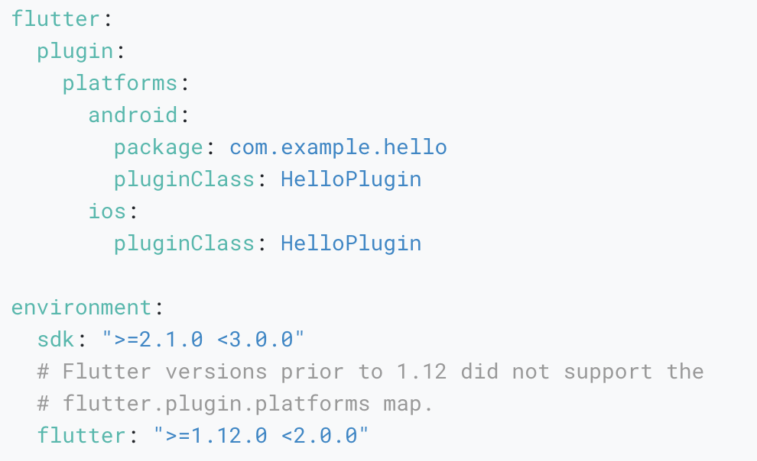
Specifying a plugin’s supported platforms
In Flutter 1.12 and later, plugins can specify the platforms they support by adding keys to the platforms map in the pubspec.yaml file.

Slide 27
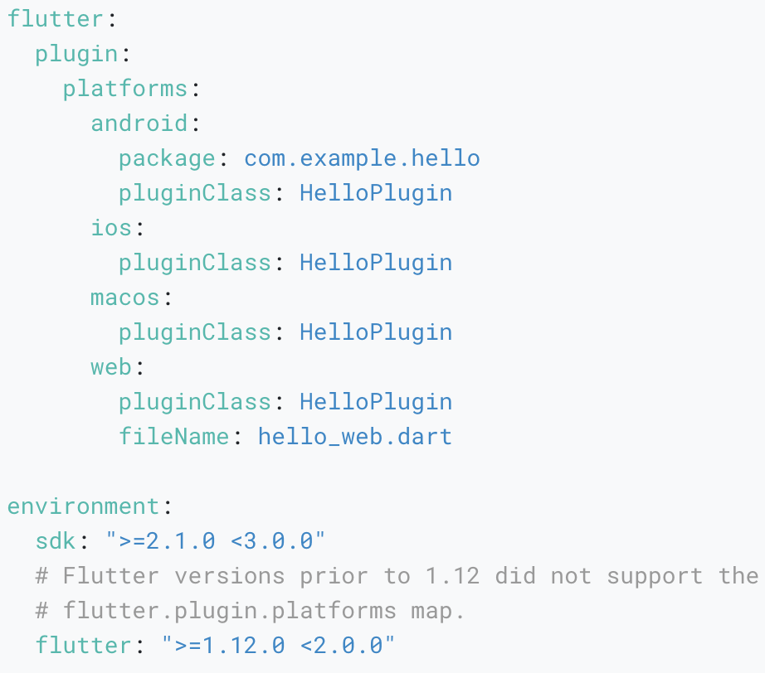
When adding plugin implementations for more platforms, the platforms map should be updated accordingly.

Slide 28
Step 1: Create the package
To create a plugin package, use the --template=plugin flag with flutter create.
Use the --org option to specify your organization, using reverse domain name notation.

Slide 29
Step 2: Implement the package
Step 2a: Define the package API (.dart)
The API of the plugin package is defined in Dart code. Open the main hello/ folder in your favorite Flutter editor. Locate the file lib/hello.dart.
Step 2b: Add Android platform code (.kt/.java)
We recommend you edit the Android code using Android Studio.
Step 2c: Add iOS platform code (.swift/.h+.m)
We recommend you edit the iOS code using Xcode.
Step 2d: Connect the API and the platform code
Finally, you need to connect the API written in Dart code with the platform-specific implementations.

Slide 30
Adding documentation
It is recommended practice to add the following documentation to all packages:
A README.md file that introduces the package
A CHANGELOG.md file that documents changes in each version
A LICENSE file containing the terms under which the package is licensed
API documentation for all public APIs (see below for details)

Slide 31
API documentation
When you publish a package, API documentation is automatically generated and published to pub.dev/documentation.
Adding licenses to the LICENSE file
Individual licenses inside each LICENSE file should be separated by 80 hyphens on their own on a line.

Slide 32
Publishing your package
Once you have implemented a package, you can publish it on pub.dev, so that other developers can easily use it.
Prior to publishing, make sure to review the pubspec.yaml, README.md, and CHANGELOG.md files to make sure their content is complete and correct.
Also to consider including the following items:
Diverse code usage examples
Screenshots, animated gifs, or videos
A link to the corresponding code repository

Slide 33
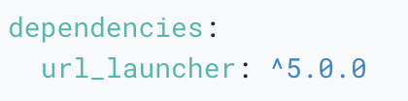
Handling package interdependencies
If you are developing a package hello that depends on the Dart API exposed by another package, you need to add that package to the dependencies section of your pubspec.yaml file.

Slide 34
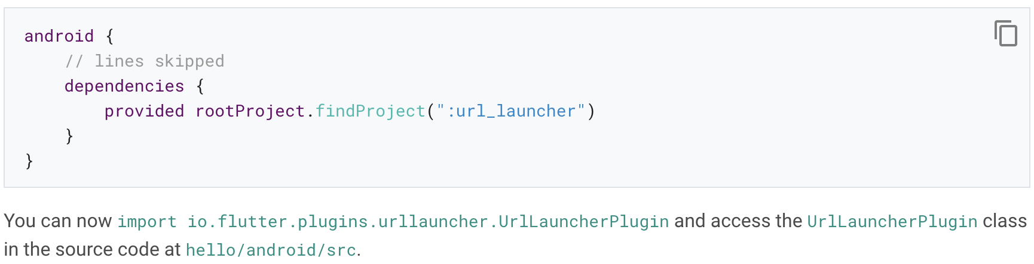
Android
The following example sets a dependency for url_launcher in hello/android/build.gradle:

Slide 35
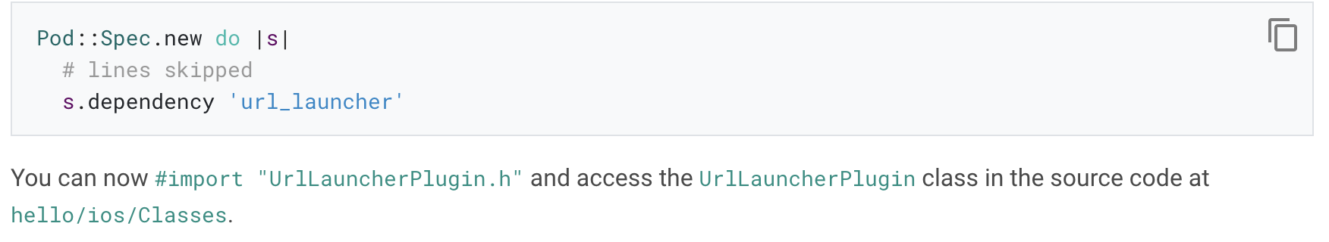
iOS
The following example sets a dependency for url_launcher in hello/ios/hello.podspec:

Slide 36
Web
All web dependencies are handled by the pubspec.yaml file like any other Dart package.

Slide 37
Flutter Favorite program
Notes:
StatelessWidget is used for immutable elements that only rely on the object configuration information
StatefulWidget is used for elements that can dynamically change based on state-changes in the system
Everytime that state changes, setChange() is called by the object

Slide 38
Introduction
The aim of the Flutter Favorite program is to identify packages and plugins that you should first consider when building your app.
This is not a guarantee of quality or suitability to your particular situation—you should always perform your own evaluation of packages and plugins for your project.

Slide 39
Metrics
Flutter Favorite packages have passed high quality standards using the following metrics:
Overall package score
Permissive license, including (but not limited to) Apache, Artistic, BSD, CC BY, MIT, MS-PL and W3C
GitHub version tag matches the current version from pub.dev, so you can see exactly what source is in the package
Feature completeness—and not marked as incomplete (for example, with labels like “beta” or “under construction”)
Verified publisher
General usability when it comes to the overview, docs, sample/example code, and API quality
Good runtime behavior in terms of CPU and memory usage
High quality dependencies

Slide 40
Flutter Ecosystem Committee
The Flutter Ecosystem Committee (FEC) is comprised of Flutter team members and Flutter community members spread across its ecosystem.
One of the their jobs is to decide when a package has met the quality bar to become a Flutter Favorite.

Slide 41
What’s next
Use of the new pubspec.yaml format that clearly indicates which platforms are supported.
Support for the latest stable version of Flutter.
Support for AndroidX.
Support for multiple platforms, such as web, macOS, Windows, Linux, etc.
Integration as well as unit test coverage.

Slide 42
Thank you!
Wenxuan Shi
College of Software, Nankai University
Email: shiwx@nankai.edu.cn
Wechat: 13920561100

